Slide 1
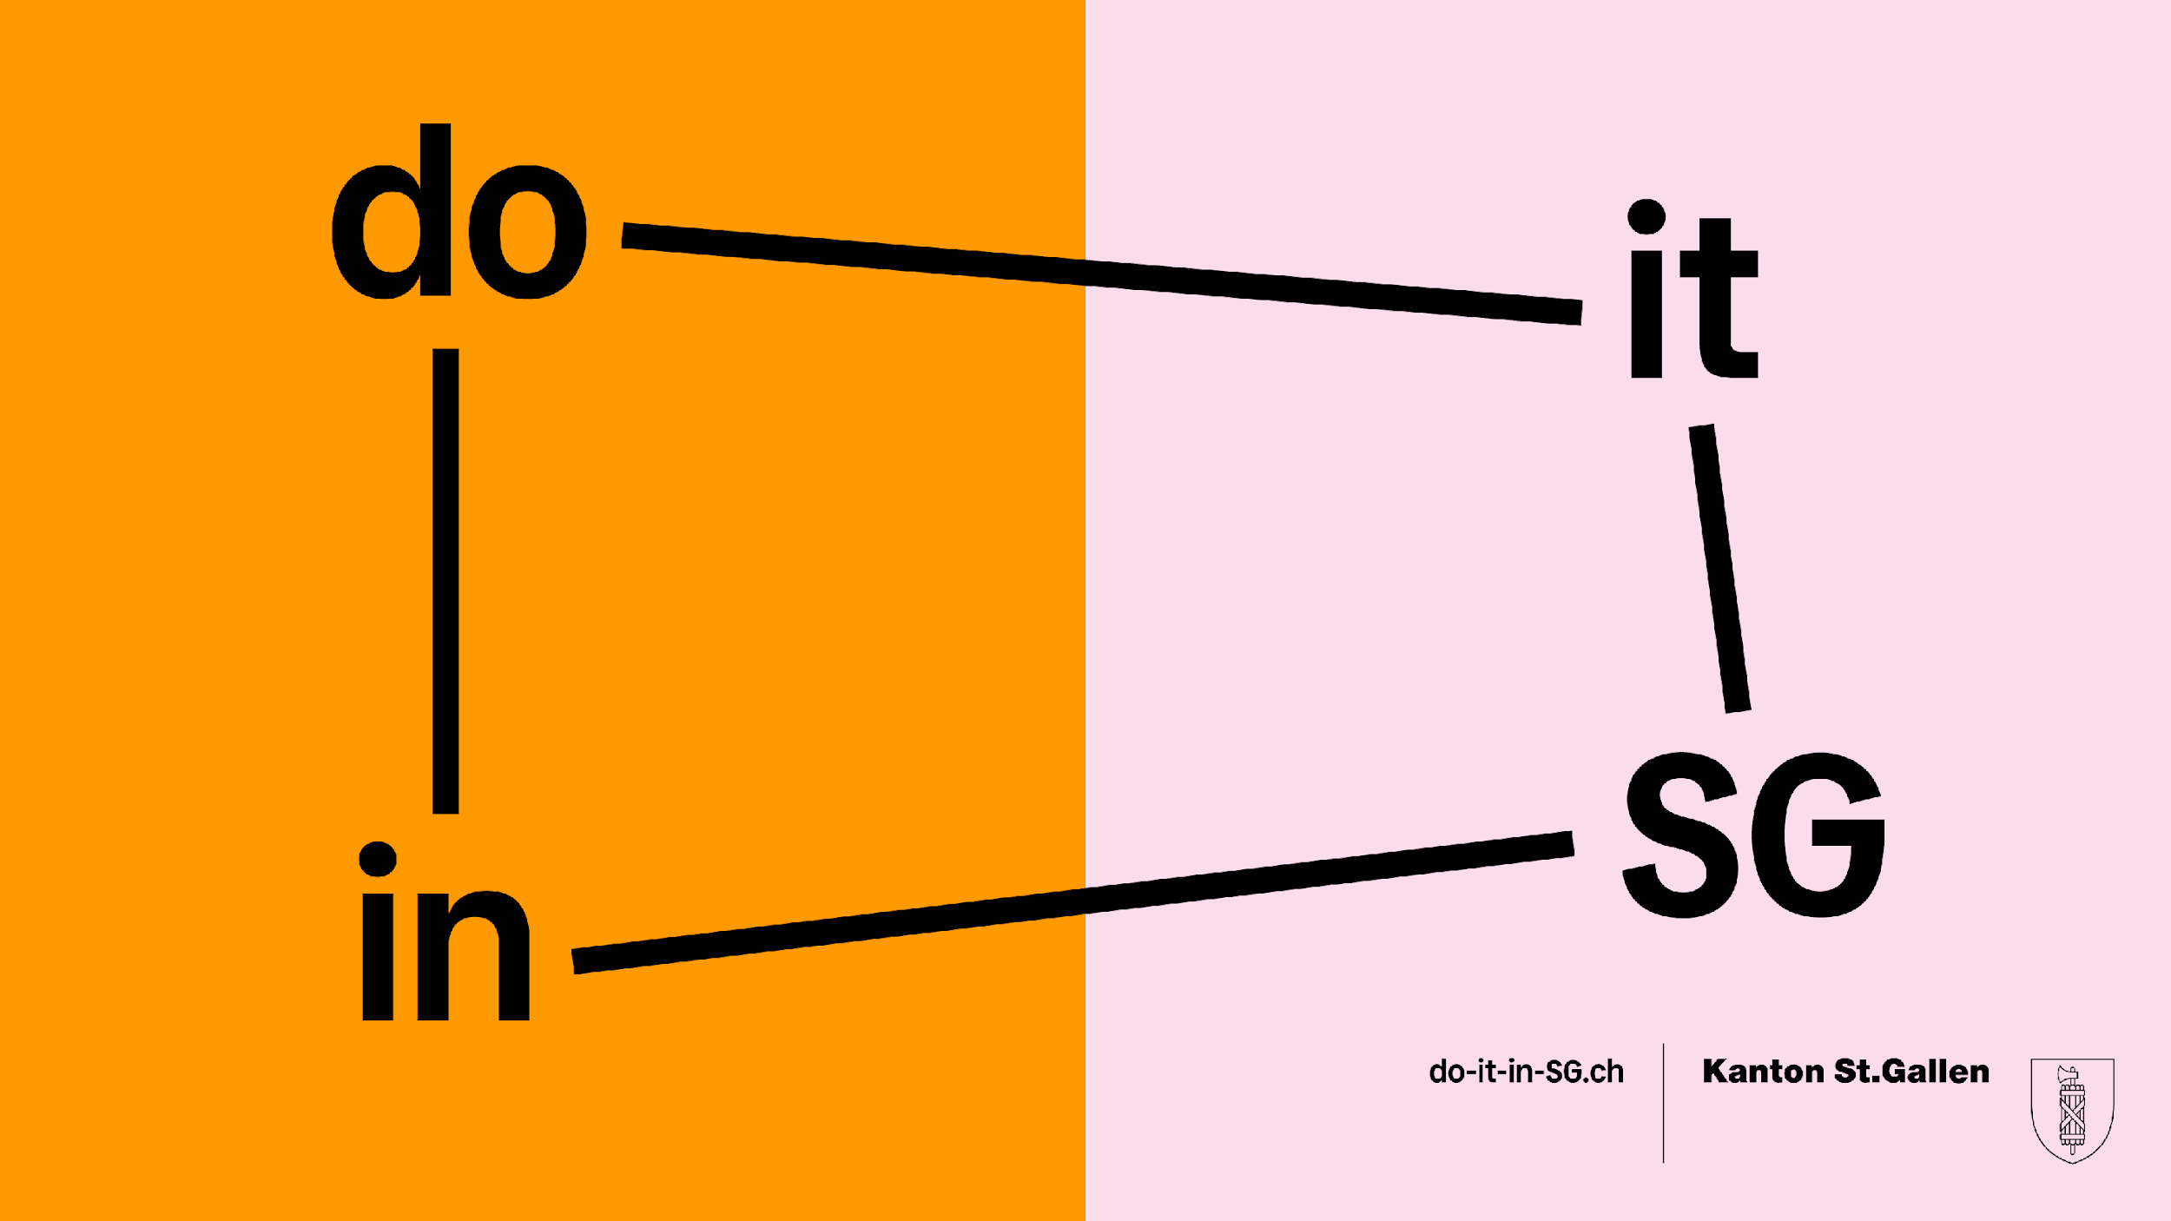

Slide 2
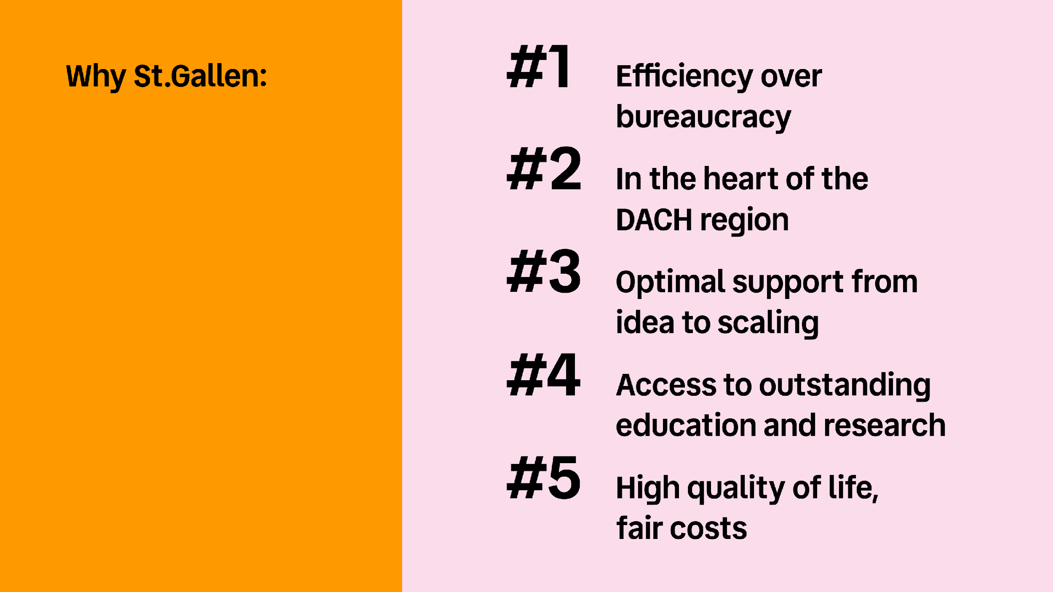

Slide 3
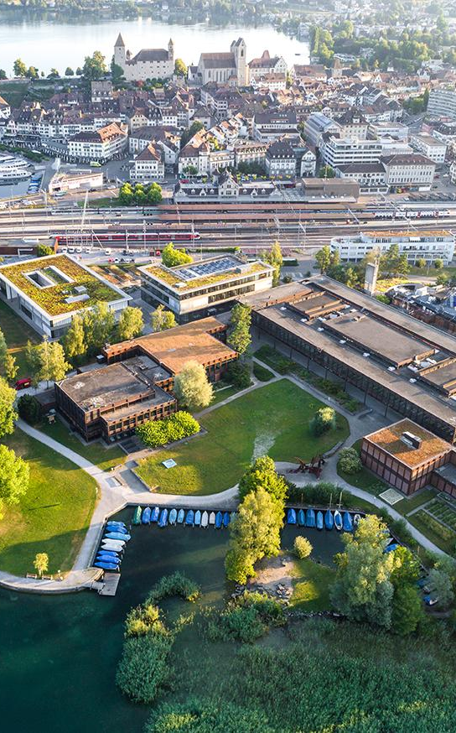
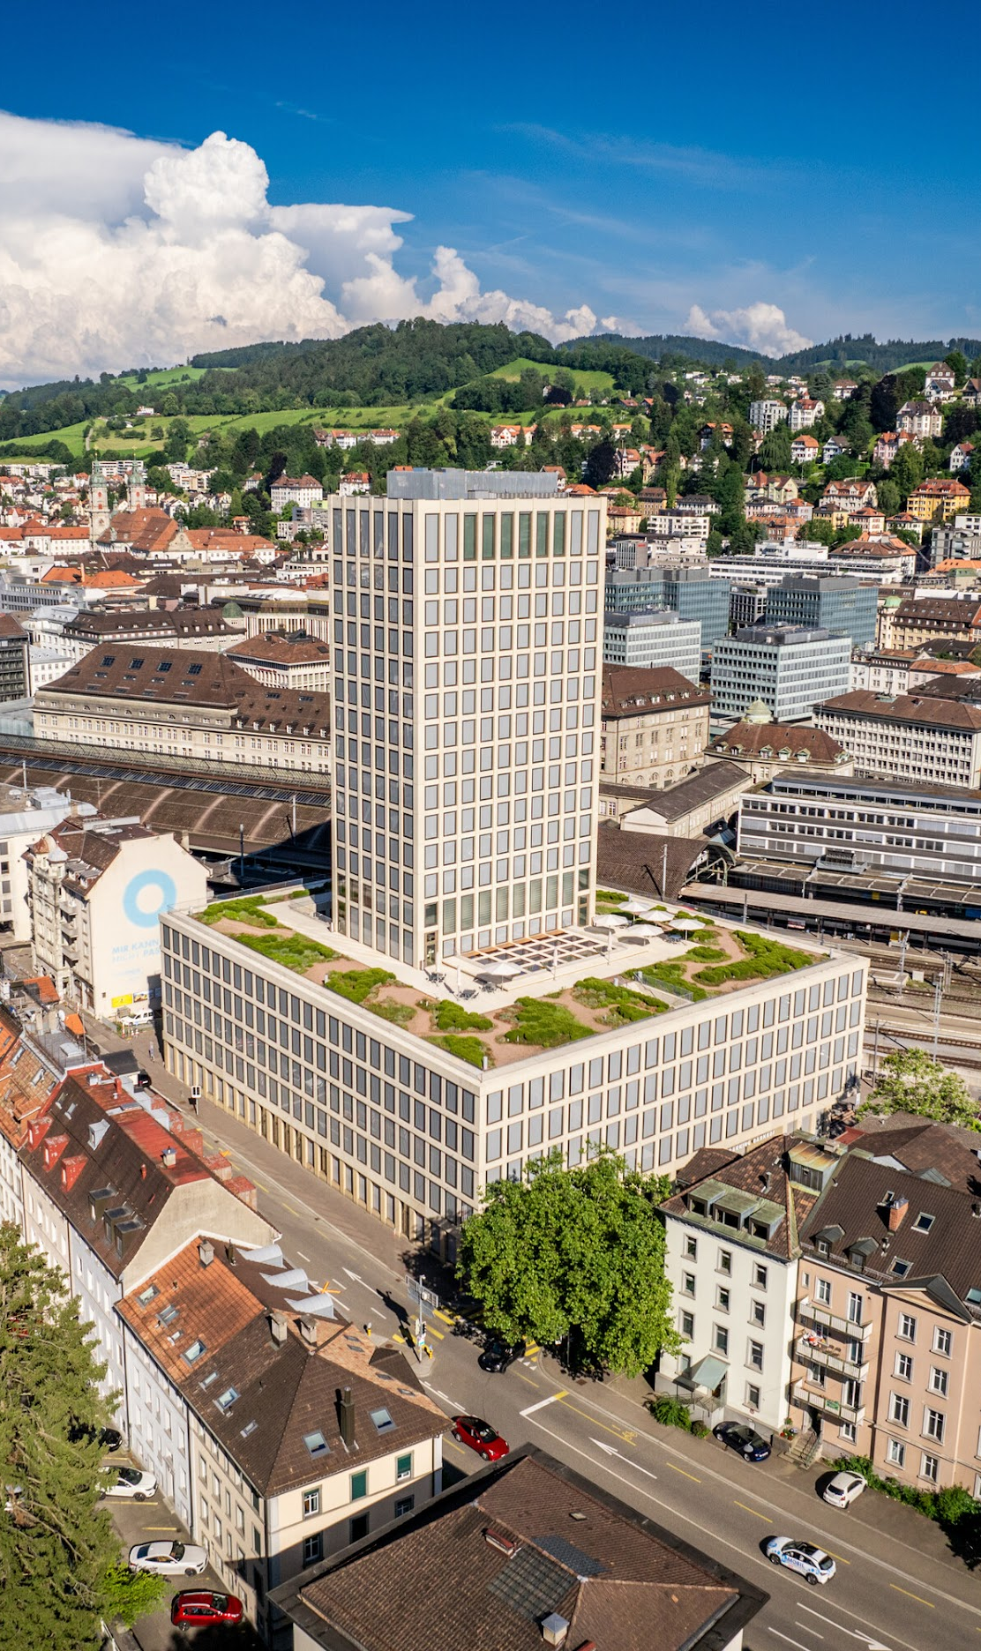
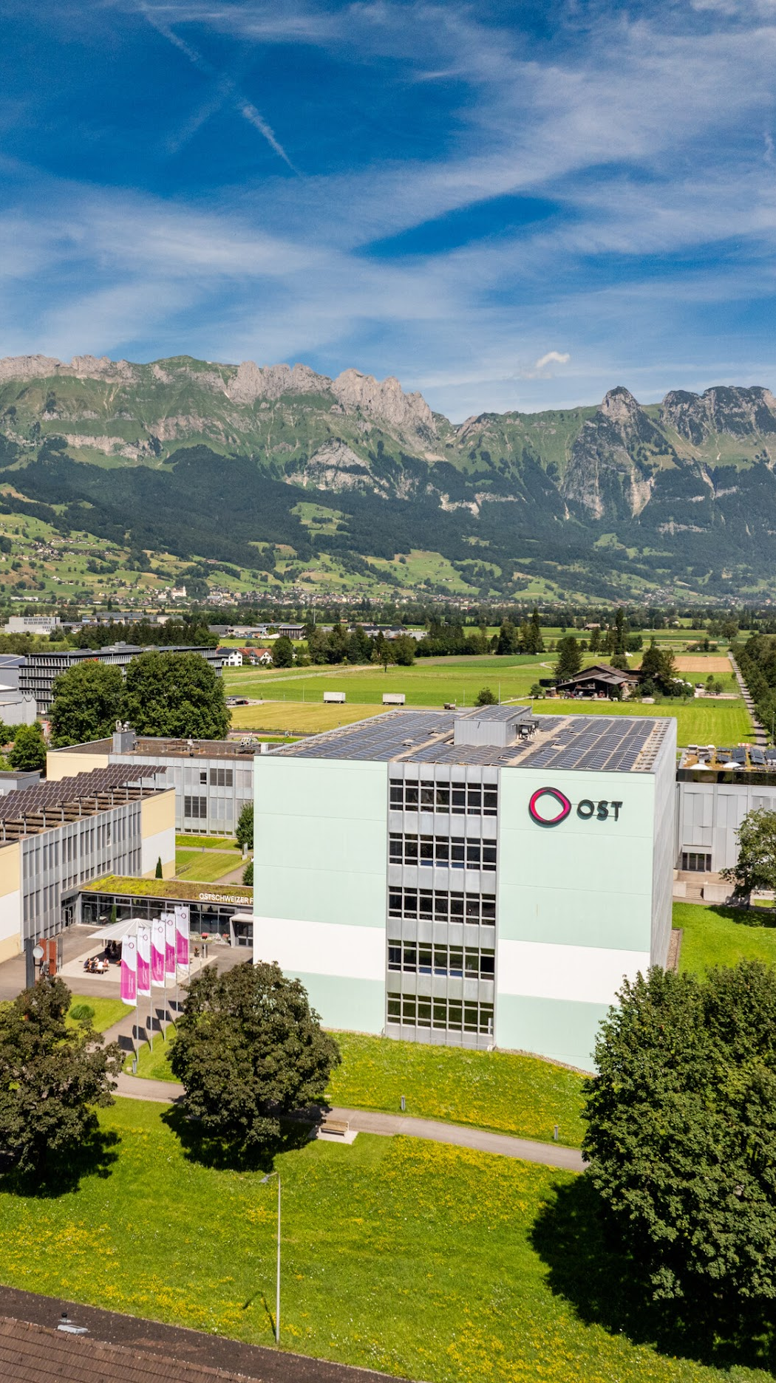

St.Gallen
Buchs
We are a dynamic, innovative university that strengthens the Eastern Switzerland region with forward-looking initiatives and makes a significant contribution to its economic and social development.
6 Schools
18 Bachelor & 17 Master Programs
3’800 Students
1’000 Research Projects
Rapperswil

Slide 4


In Switzerland alone
100’000

Slide 5





We connect companies with students and researchers

Slide 6
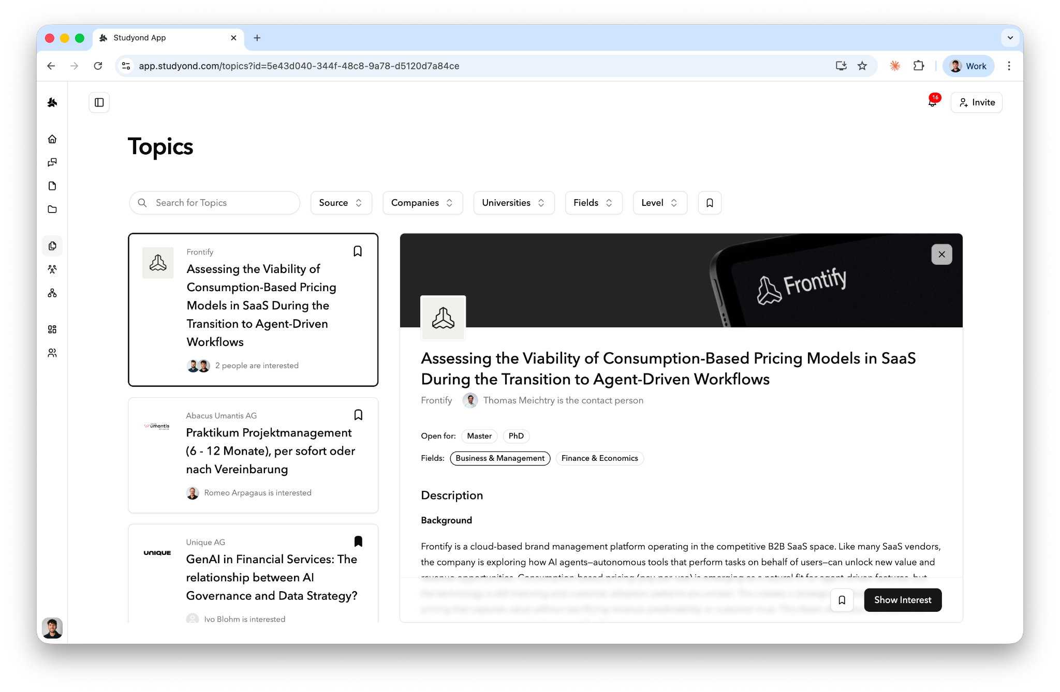

Nearly 10’000 live topics …

Slide 7
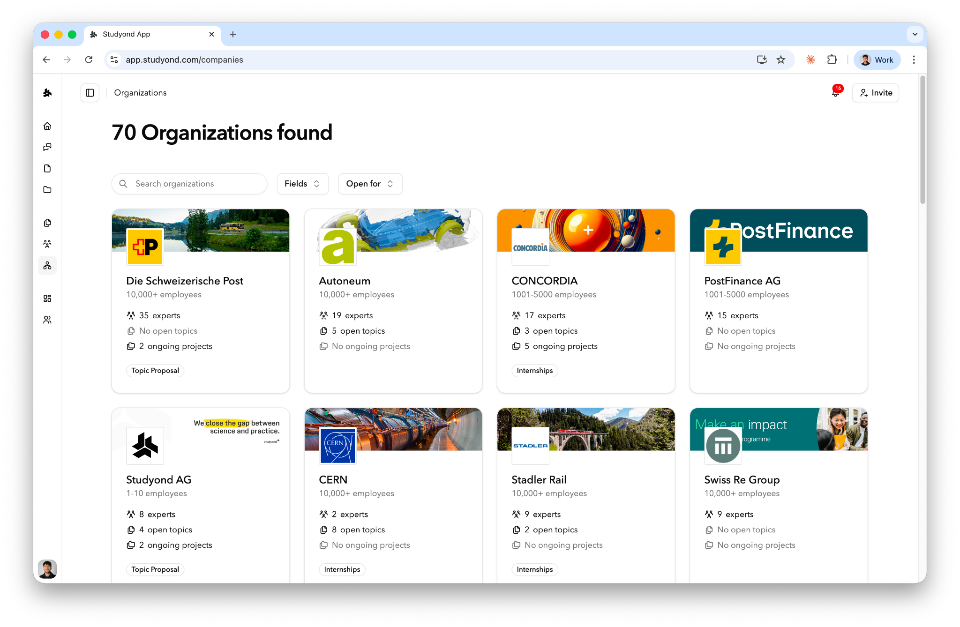

… from hundreds of organizations, …

Slide 8
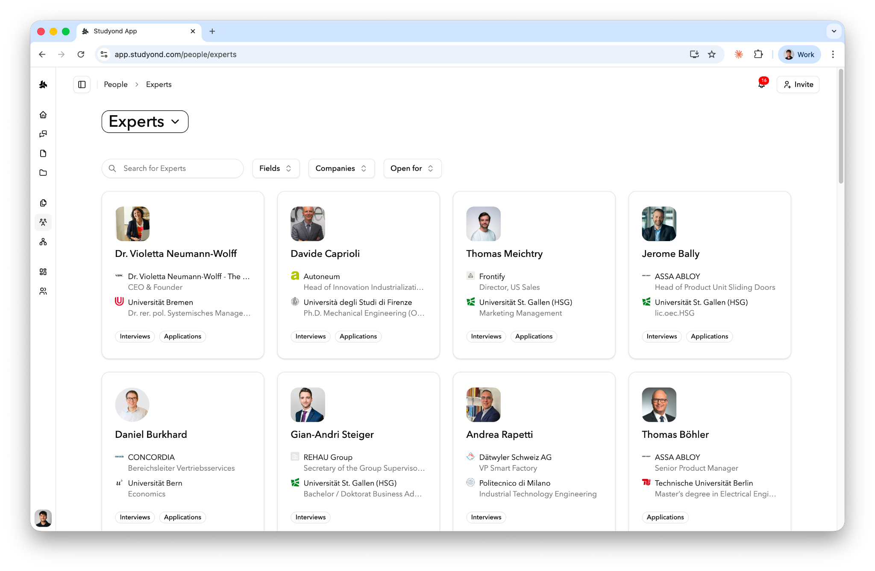

… supervisors, and company experts.

Slide 9
Our challenge for you
Rethink thesis projects
in the Age of AI.

Slide 10
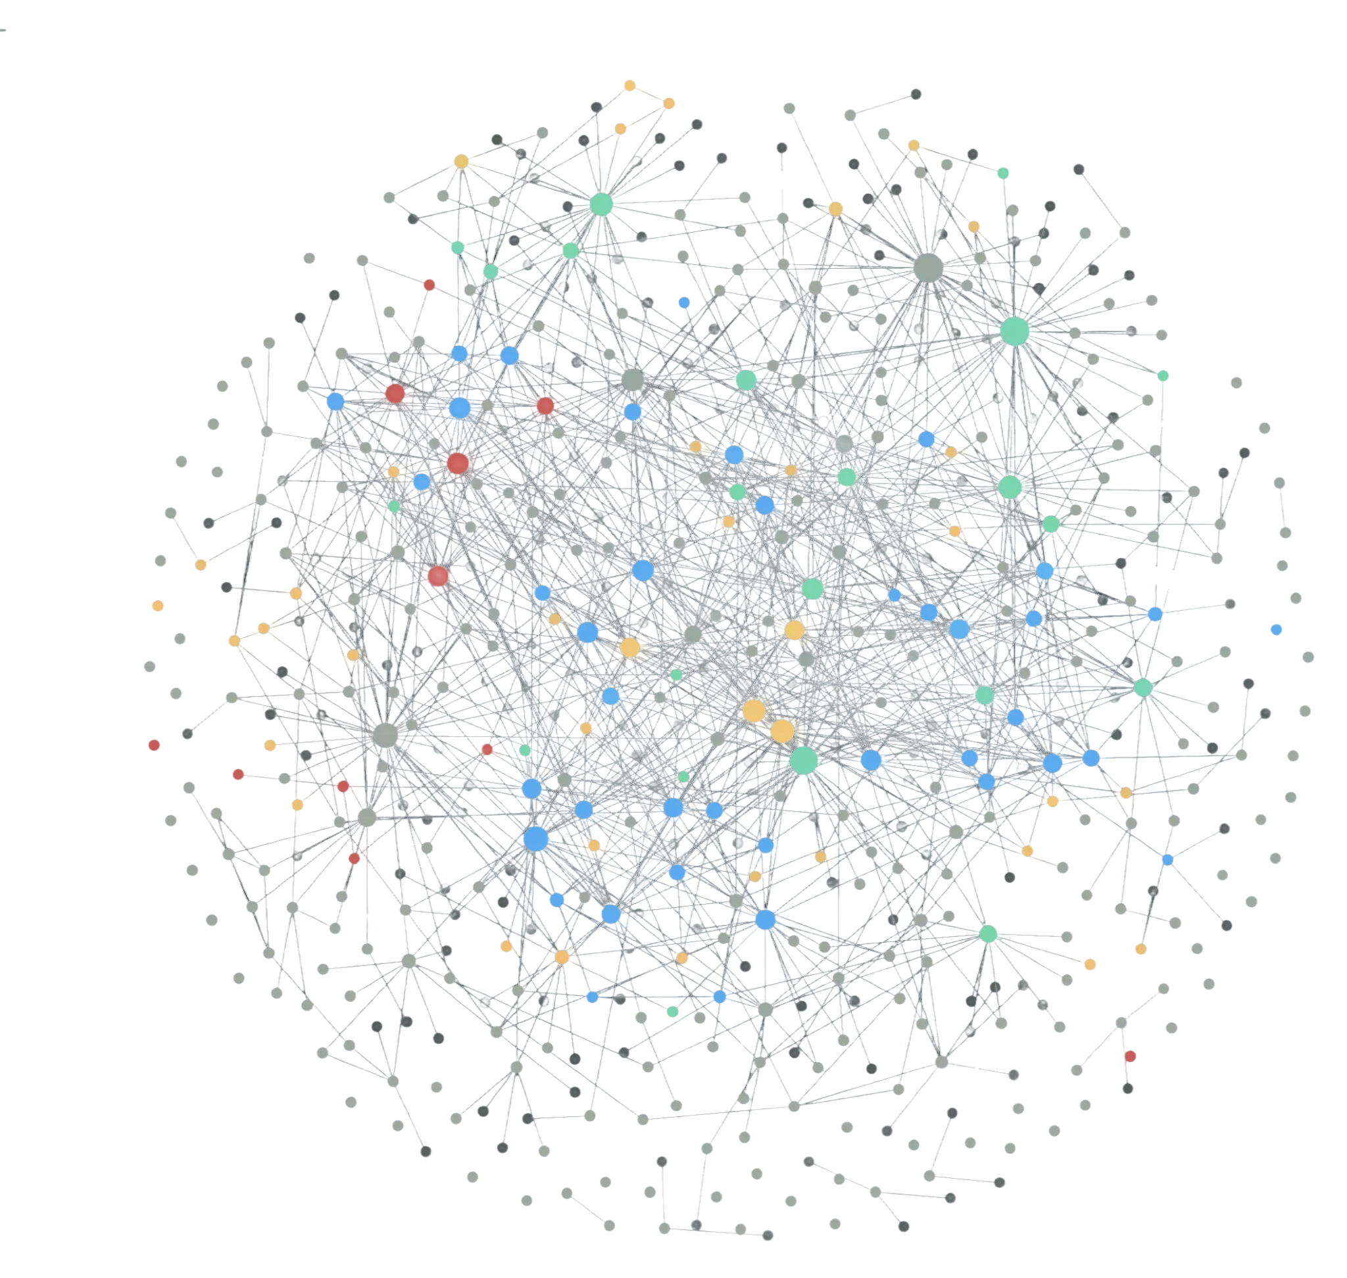




What we provide you with
Don’t waste time creating mock data - we’ve prepared it
For context: Connect your LLM directly to our “Studyond Brain” (MCP)
For the backend guys among you: Use our AI-friendly design guidelines

Slide 11
Together we can shape the future for thousands of students
Build the thesis journey
you wish existed.

